Slide 1


Introduction to Telemedicine
Telemedicine is the use of technology to deliver healthcare services remotely. It allows patients to consult with healthcare providers without having to physically visit a clinic or hospital. Telemedicine has revolutionized the way healthcare is delivered.
EM
by Emmanuel Mmeah

Slide 2


Benefits of Telemedicine
1
Improved Accessibility
2
Reduced Wait Times
Telemedicine provides access to healthcare for those living in remote areas or with limited mobility.
Patients can often get appointments faster through telemedicine, reducing the need to wait for in-person consultations.
3
Increased Convenience
4
Greater Efficiency
Telemedicine allows patients to receive healthcare from the comfort of their own homes or offices, eliminating the need to travel.
Telemedicine can streamline healthcare delivery, leading to more efficient use of resources and improved patient outcomes.

Slide 3
Improved Access to Healthcare
Rural Communities
Underserved Populations
Global Reach
Telemedicine brings healthcare to underserved rural communities, providing access to specialists and services that might otherwise be unavailable.
Telemedicine can help reach vulnerable populations who may face barriers to accessing traditional healthcare, such as those with disabilities or chronic conditions.
Telemedicine enables healthcare professionals to consult with patients across borders, expanding the reach of healthcare services.

Slide 4


Reduced Costs for Patients
Lower Travel Costs
Reduced Time Off Work
Lower Healthcare Costs
Telemedicine eliminates the need for patients to travel to healthcare facilities, reducing transportation expenses.
Telemedicine appointments often require less time off work, leading to increased productivity and reduced lost wages.
Telemedicine can sometimes be more affordable than traditional in-person healthcare, especially for routine check-ups and consultations.

Slide 5





Enhanced Patient Engagement
Increased Patient Participation
Patients can actively participate in their healthcare by accessing their medical records and communicating directly with their providers.
Improved Communication
Telemedicine platforms allow for clear and timely communication between patients and healthcare providers, fostering a stronger relationship.
Personalized Care
Patients can access a wider range of healthcare options tailored to their individual needs and preferences through telemedicine.

Slide 6


Convenience and Flexibility
1
Flexible Scheduling
Patients can schedule appointments at times that are convenient for them, outside of traditional clinic hours.
2
Location Independence
Patients can receive care from anywhere with an internet connection, offering greater flexibility and accessibility.
3
Reduced Time Commitment
Telemedicine appointments often take less time than in-person visits, saving patients valuable time and effort.

Slide 7
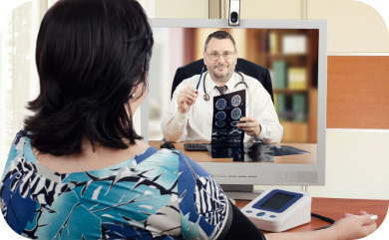

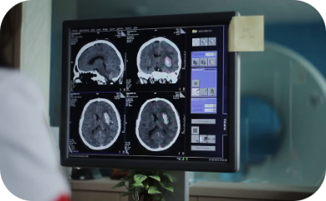

Technological Advancements in Telemedicine
High-Definition Video Conferencing
Wearable Health Devices
Remote Patient Monitoring
Artificial Intelligence
AI algorithms are being integrated into telemedicine platforms to analyze patient data, provide personalized recommendations, and automate tasks.
Enhanced video conferencing technology provides clear and realistic communication between patients and providers.
Wearable devices can track vital signs and health metrics, providing real-time data to healthcare providers.
Remote patient monitoring technologies allow healthcare providers to track patient health remotely, enabling early intervention and better management of chronic conditions.

Slide 8


Conclusion and Call to Action
Telemedicine is transforming healthcare, offering numerous benefits to both patients and healthcare providers. By embracing telemedicine, we can create a more accessible, affordable, and patient-centered healthcare system.

